Slide 1






Enhanced environmental protection inspection for efficient control of air quality monitoring and of all entities under obligation within system of greenhouse gas emission allowance trading, in order to achieve better quality of air in Republic of Croatia
This project is funded by the European Union

Slide 2



TOPIC 16: Data usage practical implementation
Energy research and Environmental Protection Institute

Slide 3
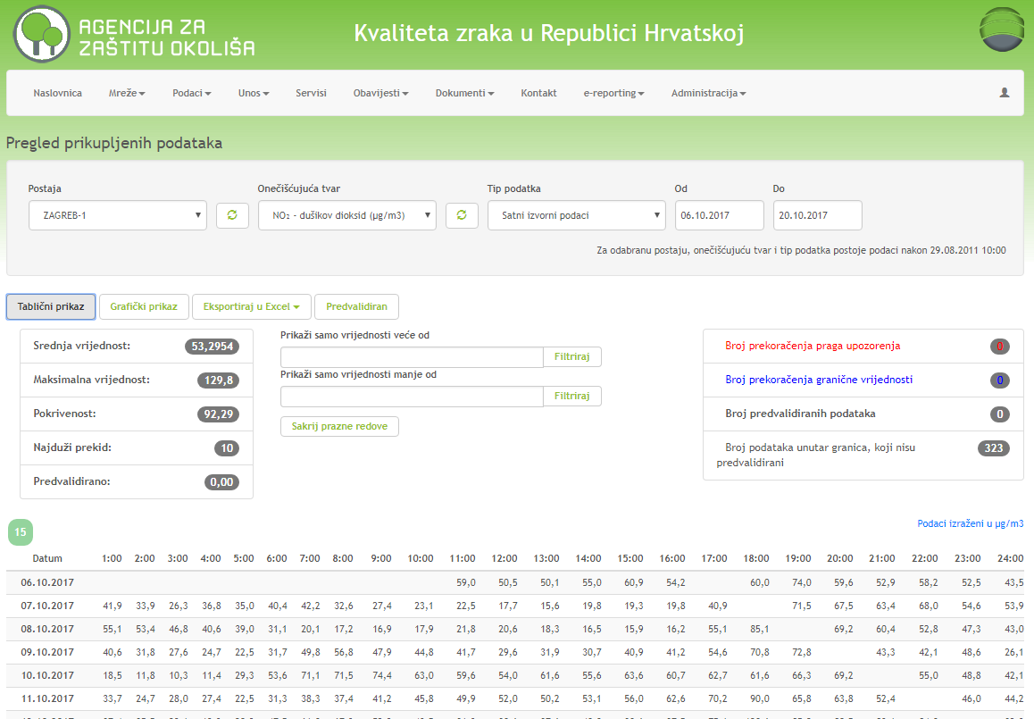

16.1 INTERPRETATION OF AIR QUALITY DATA BEFORE AND AFTER VALIDATION
European Union IPA 2013 Programme for Croatia
Air quality portal in RC – possibility of three types of data :
Original (current measuring values)
Validated data (past validation process)
Pre-validated (currently they are not on portal as no one submits validated data continuously)
Depending on pollutant, data can be of hourly, daily, 8-hourly or maximum 8-hourly daily value
http://iszz.azo.hr/iskzl/podatak.htm
Institut za energetiku i zaštitu okoliša
Energy Research and Environmental Protection Institute

Slide 4
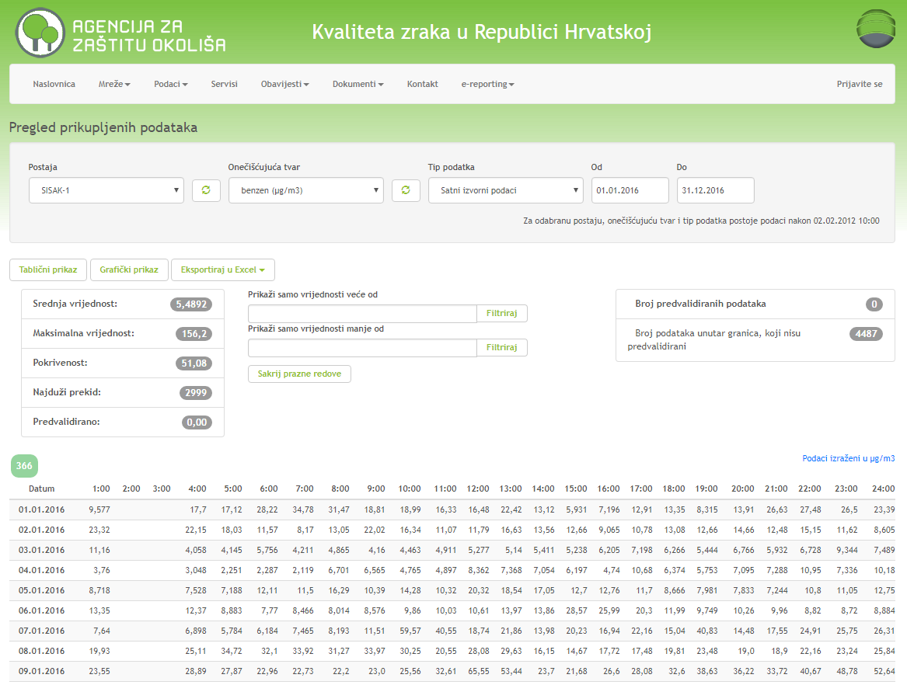
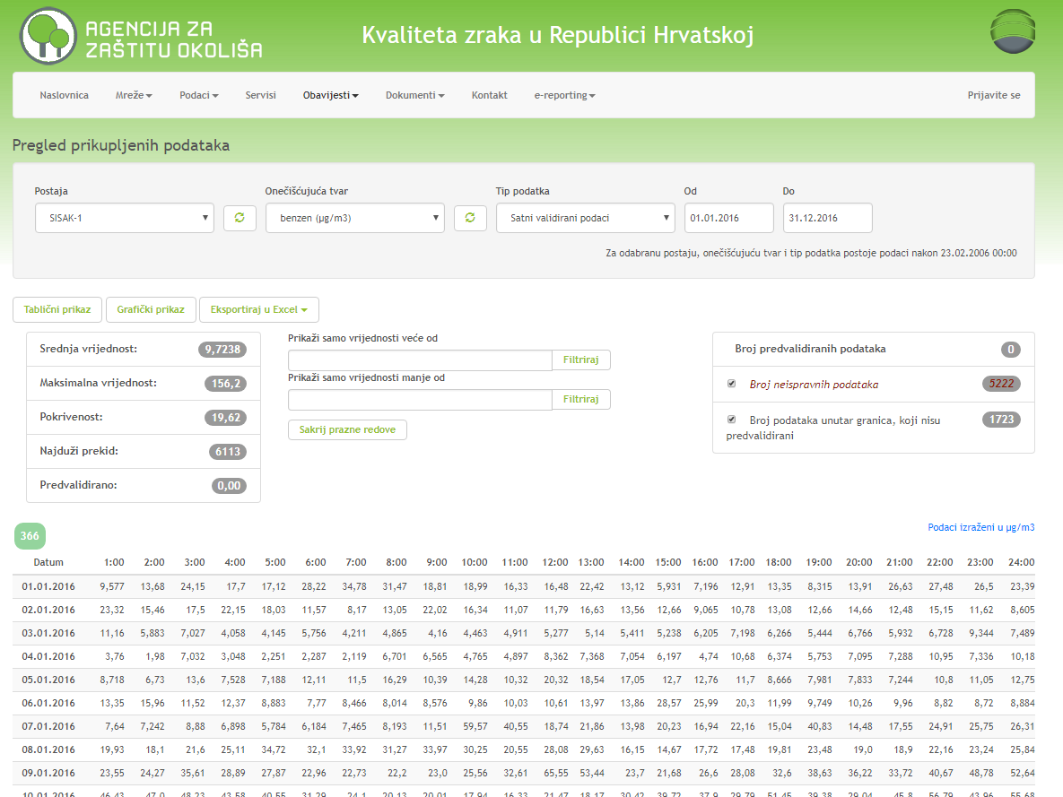
16.1 INTERPRETATION OF AIR QUALITY DATA BEFORE AND AFTER VALIDATION
European Union IPA 2013 Programme for Croatia
Comparison of original and validated data - Air quality portal in RC
Example: Sisak-1 – Benzene – 2016 – difference in data
Original data
Validated data
Energy Research and Environmental Protection Institute
http://iszz.azo.hr/iskzl/podatak.htm
Institut za energetiku i zaštitu okoliša

Slide 5
16.1 INTERPRETATION OF AIR QUALITY DATA BEFORE AND AFTER VALIDATION
European Union IPA 2013 Programme for Croatia
Comparison of original and validated data - Air quality portal in RC
Example: Sisak-1 – Benzene – 2016 – difference in data
Original data
Coverage: 51.08 %
No. of data: 4487
Mean value: 5.4892
Maximum value: 156.2
Longest interruption: 2999
Pre-validated: 0.00
Validated data
Coverage: 19.62 %
No. of data: 1723
Mean value: 9.7238
Maximum value: 156.2
Longest interruption: 6113
Pre-validated: 0.00
http://iszz.azo.hr/iskzl/podatak.htm
Institut za energetiku i zaštitu okoliša
Energy Research and Environmental Protection Institute

Slide 6
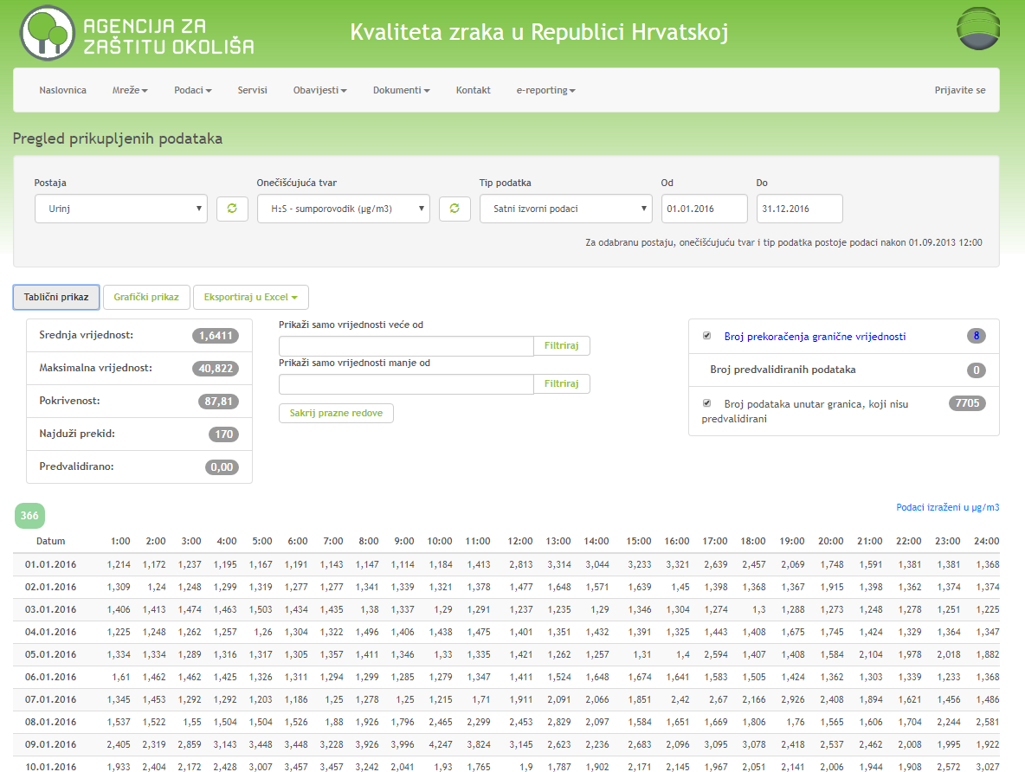
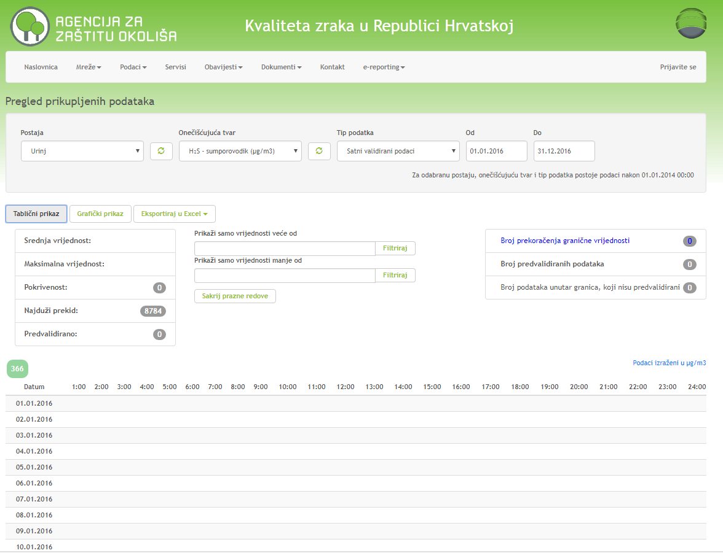
16.1 INTERPRETATION OF AIR QUALITY DATA BEFORE AND AFTER VALIDATION
European Union IPA 2013 Programme for Croatia
Comparison of original and validated data - Air quality portal in RC
Example: Urinj – H₂S – 2016 – often case, no validated data at all
Original data
Validated data
http://iszz.azo.hr/iskzl/podatak.htm
Institut za energetiku i zaštitu okoliša
Energy Research and Environmental Protection Institute

Slide 7
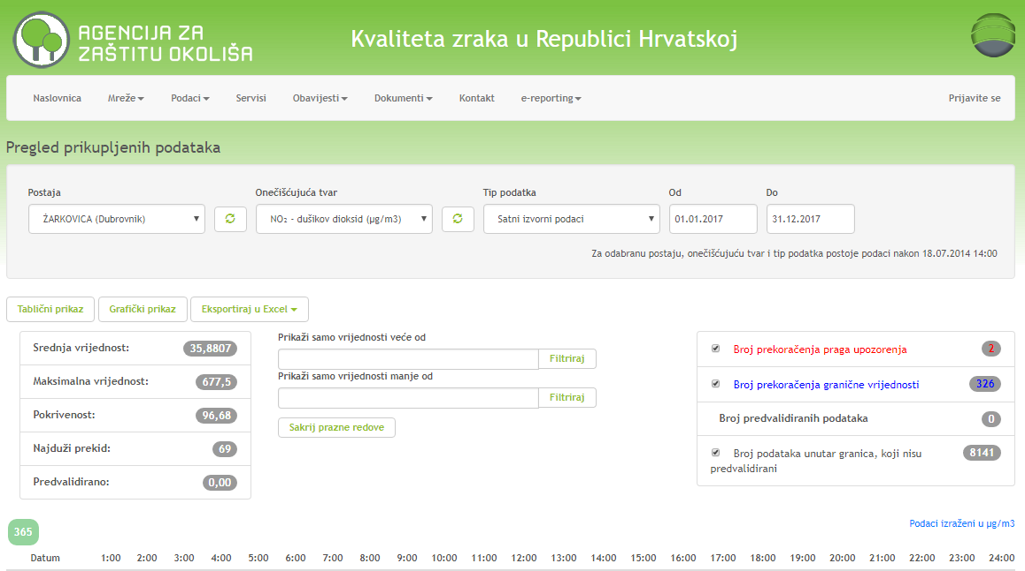
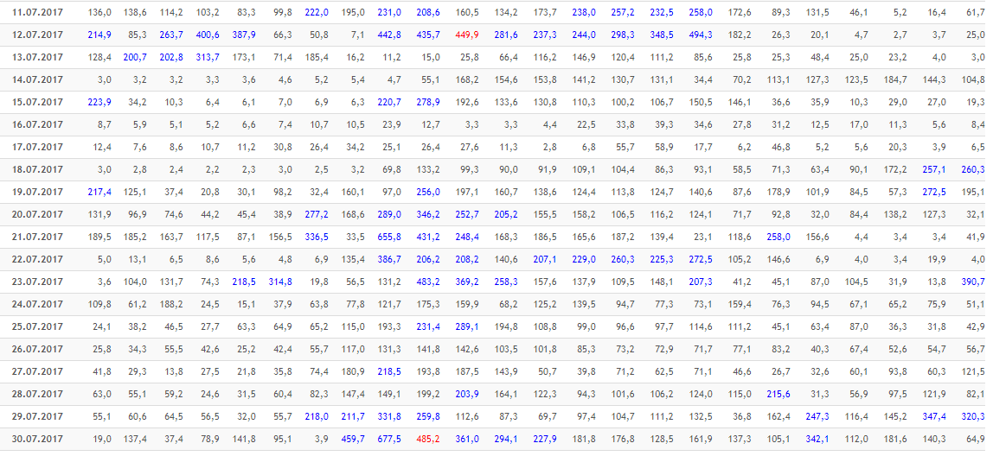
16.1 INTERPRETATION OF AIR QUALITY DATA BEFORE AND AFTER VALIDATION
European Union IPA 2013 Programme for Croatia
Original data - example
Žarkovica – NO₂ – 2017
Exceeding of allert threshold were registered two times.
The question arise – are these data correct/valid (still there are no validated data for 2017)
- if yes, did anyoune react according to APA and Regulation on the Pollutant Levels in Air
- if they are not correct/valid, then what …….
- No. of exceeding of LV = 326???
Institut za energetiku i zaštitu okoliša
Energy Research and Environmental Protection Institute

Slide 8
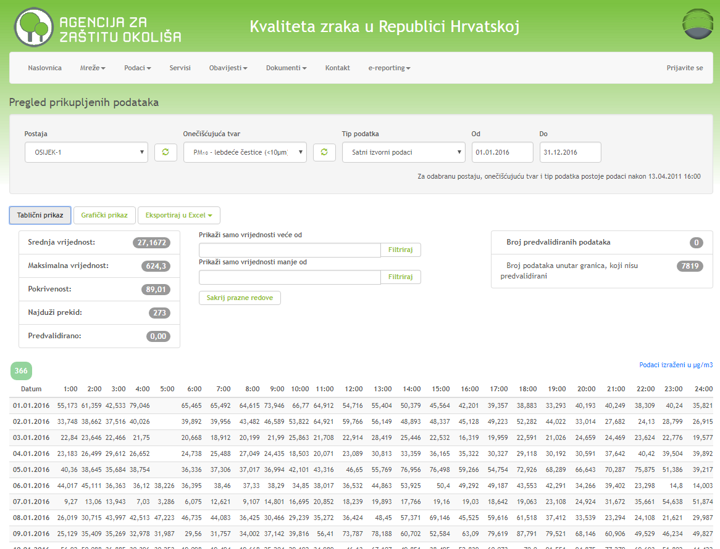
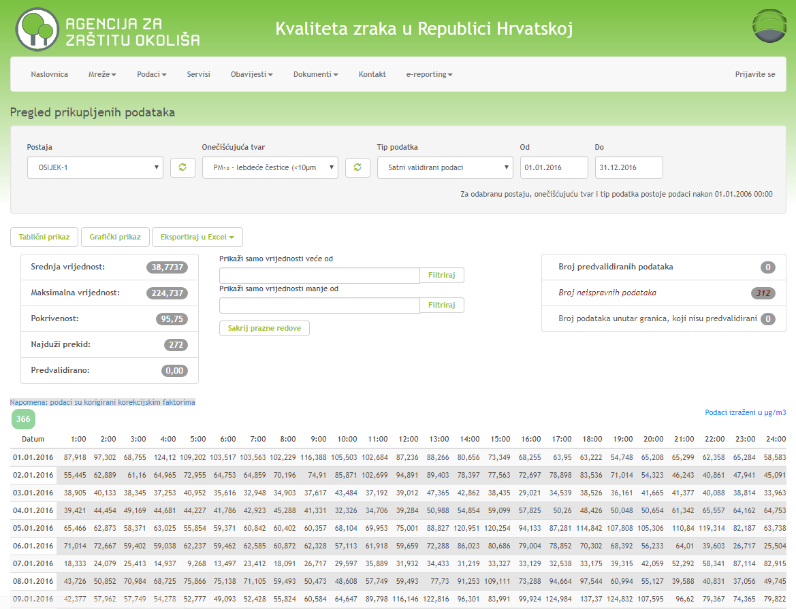
16.1 INTERPRETATION OF AIR QUALITY DATA BEFORE AND AFTER VALIDATION
European Union IPA 2013 Programme for Croatia
Comparison of original and validated data - Air quality portal in RC
Example: Osijek-1 – PM₁₀ – 2016 – validated data are corrected by correcting factors from the equivalency study
Original data
Validated data
http://iszz.azo.hr/iskzl/podatak.htm
Institut za energetiku i zaštitu okoliša
Energy Research and Environmental Protection Institute

Slide 9
16.1 INTERPRETATION OF AIR QUALITY DATA BEFORE AND AFTER VALIDATION
European Union IPA 2013 Programme for Croatia
Comparison of original and validated data - Air quality portal in RC
Example: Osijek-1 – PM₁₀ – 2016 – validated data are corrected by correcting factors from the equivalency study
Original data
Hourly
Coverage: 89.01 %
Mean value: 27.1672
Maximum value: 624.3
Daily
Coverage: 92.35 %
Mean value: 26.854
Maximum value: 81.946
No. of exceeding of LV: 26
Validated data
Hourly
Coverage: 95.75 %
Mean value: 38.7737
Maximum value: 224.737
Daily
Coverage: 96.17 %
Mean value: 38.87
Maximum value: 125.518
No. of exceeding of LV: 82
http://iszz.azo.hr/iskzl/podatak.htm
Institut za energetiku i zaštitu okoliša
Energy Research and Environmental Protection Institute

Slide 10
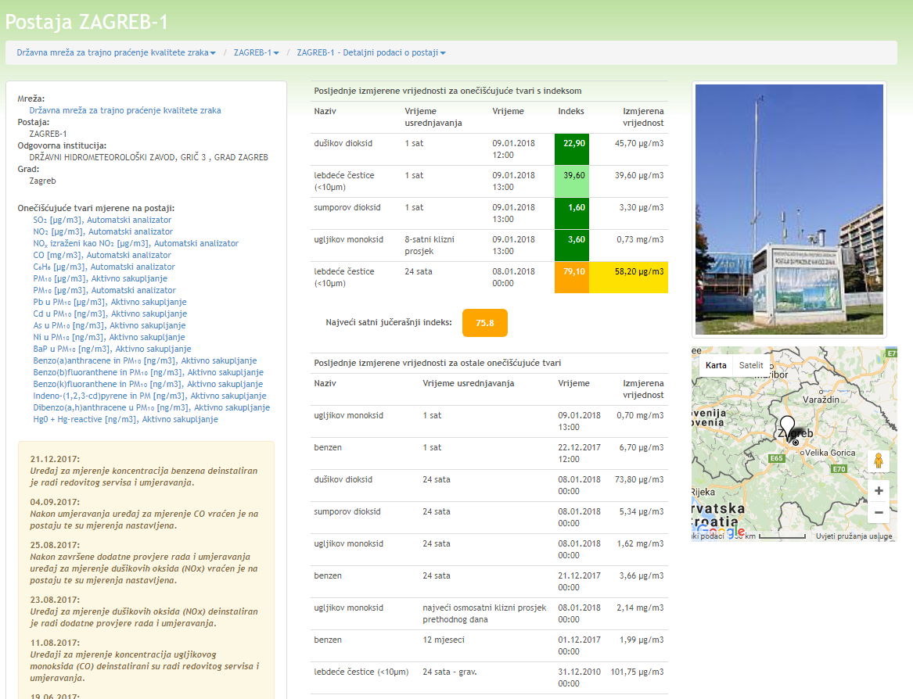
16.1 INTERPRETATION OF AIR QUALITY DATA BEFORE AND AFTER VALIDATION
European Union IPA 2013 Programme for Croatia
Notices
On station web page there are notices on interruption of every measuring instrument e.g.:
11.08.2017: Devices for measuring the concentrations of carbon monoxide (CO) are dismantled due to a regular servicing and calibration.
04.09.2017: After calibration, the device for CO measurement is returned to the station and measurements are continued .
http://iszz.azo.hr/iskzl/postaja.html?id=155
Institut za energetiku i zaštitu okoliša
Energy Research and Environmental Protection Institute

Slide 11
16.1 INTERPRETATION OF AIR QUALITY DATA BEFORE AND AFTER VALIDATION
European Union IPA 2013 Programme for Croatia
Measuring result and measuring uncertainty
Every measuring result can be indicated with certain measuring uncertainty.
The question arises:
How to evaluate measuring result with its measuring uncertainty as regarding the limit value?
If there is no specification for certain technical area regarding the evaluation of result with measuring uncertainty, then the accreditation documents are used :
ILAC-G8:03/2009 - Guidelines on the Reporting of Compliance with Specification
HAA Up-1-4 – Instructions for indicating the statement of conformity
Institut za energetiku i zaštitu okoliša
Energy Research and Environmental Protection Institute

Slide 12
16.1 INTERPRETATION OF AIR QUALITY DATA BEFORE AND AFTER VALIDATION
European Union IPA 2013 Programme for Croatia
Measuring result and measuring uncertainty
In general, there are 4 possible cases:
Case 1 and Case 4 are completely clear :
Case 1 = result is complied with specification
Case 4 = result is not complied with specification
Case 2 and Case 3 represent limit cases which could be interpreted in various ways.
Institut za energetiku i zaštitu okoliša
Energy Research and Environmental Protection Institute

Slide 13
16.1 INTERPRETATION OF AIR QUALITY DATA BEFORE AND AFTER VALIDATION
European Union IPA 2013 Programme for Croatia
Measuring result and measuring uncertainty
According to ILAC G8:
- compliance cannot be indicated for Case 2 and Case 3.
According to HAA-Up-1/4:
- for Case 2 and Case 3 is not possible to state the compliance using 95-percentage probability of coverage for extended uncertainty, but the measuring result is under/above the limit.
Institut za energetiku i zaštitu okoliša
Energy Research and Environmental Protection Institute

Slide 14
16.1 INTERPRETATION OF AIR QUALITY DATA BEFORE AND AFTER VALIDATION
European Union IPA 2013 Programme for Croatia
Measuring result and measuring uncertainty
According to the Regulation on Pollutant Emission Monitoring into the Air from Stationary Sources, OG 129/12, Article 18:
(1) Evaluation of emission measuring results is carried out by comparing the measuring results with prescribed limit values according to the Regulation on ELV or Decision on integrated environmental protection requirements.
(2) If the highest value of pollutant measuring result (Emj) is equal to or less than prescribed ELV (Egr), regardless the indicated measuring uncertainty, Emj ≤ Egr
– stationary source complies with prescribed ELV from paragraph 1 of this Article.
Institut za energetiku i zaštitu okoliša
Energy Research and Environmental Protection Institute

Slide 15
16.1 INTERPRETATION OF AIR QUALITY DATA BEFORE AND AFTER VALIDATION
European Union IPA 2013 Programme for Croatia
Measuring result and measuring uncertainty
According to the Regulation on Pollutant Emission Monitoring into the Air from Stationary Sources, OG 129/12, Article 18:
(3) If the highest value of pollutant measuring result is higher than prescribed ELV, but within the area of measuring uncertianty, i.e. if:
Emj – µEmj ≤ Egr
where:
µEmj – value of measuring uncertainty by measuring the established amount of pollutant value
– it is accepted that stationary source complies with prescribed ELV from paragraph 1 of this Article.
Institut za energetiku i zaštitu okoliša
Energy Research and Environmental Protection Institute

Slide 16
16.1 INTERPRETATION OF AIR QUALITY DATA BEFORE AND AFTER VALIDATION
European Union IPA 2013 Programme for Croatia
Measuring result and measuring uncertainty
According to the Regulation on Pollutant Emission Monitoring into the Air from Stationary Sources, OG 129/12, Article 18:
(4) If the highest value of pollutant measuring result reduced by measuring uncertainty is higher than prescribed ELV, i.e. if:
Emj – µEmj > Egr
where:
µEmj – value of measuring uncertainty by measuring the established amount of pollutant value
– stationary source does not comply with prescribed ELV from paragraph 1 of this Article.
Institut za energetiku i zaštitu okoliša
Energy Research and Environmental Protection Institute

Slide 17
16.1 INTERPRETATION OF AIR QUALITY DATA BEFORE AND AFTER VALIDATION
European Union IPA 2013 Programme for Croatia
Measuring result and measuring uncertainty
In summary, according to the Regulation on Pollutant Emission Monitoring into the Air from Stationary Sources, OG 129/12, Article 18:
Case 1, Case 2 and Case 3 are satisfactory!
Institut za energetiku i zaštitu okoliša
Energy Research and Environmental Protection Institute

Slide 18
16.1 INTERPRETATION OF AIR QUALITY DATA BEFORE AND AFTER VALIDATION
European Union IPA 2013 Programme for Croatia
Measuring result and measuring uncertainty
According to the Ordinance on the Air Quality Monitoring, OG 3/13, Appendix 8:
Measuring uncertainty at permanent measuring points :
SO2, NOx, CO, O3 | Benzene, fly particles
15% | 25%
Institut za energetiku i zaštitu okoliša
Energy Research and Environmental Protection Institute

Slide 19
16.1 INTERPRETATION OF AIR QUALITY DATA BEFORE AND AFTER VALIDATION
European Union IPA 2013 Programme for Croatia
Measuring result and measuring uncertainty
According to the Ordinance on the Air Quality Monitoring, OG 3/13, Appendix 8, the value of measuring uncertainty is defined and may not exceed the defined value.
According to ILAC G8, item 2.6:
‘’In testing, specification or documented practice may require a statement of conformity with specification in testing report, which does not take into consideration the effect of measuring uncertianty. In that case, specification usually contains implicite assumption that uncertainty of contractual measuring method does not vary (e.g. due to prescribed instrument classes that are used for testing).
Institut za energetiku i zaštitu okoliša
Energy Research and Environmental Protection Institute

Slide 20
16.1 INTERPRETATION OF AIR QUALITY DATA BEFORE AND AFTER VALIDATION
European Union IPA 2013 Programme for Croatia
Measuring result and measuring uncertainty
In standard or specification it should be clearly indicated that measuring uncertainty is taken into consideration when defining the limits. Specification may also be determined by national regulations in order to set up a reasonable value of measuring uncertainty („Ordinance on the Air Quality Monitoring – 15% or 25%’’).
Whenever the measuring uncertianty is not taken into consideration, it should pay a special attention when reporting. Laboratories should give remarks and explanations that would ensure unambiguous reporting.’’
Institut za energetiku i zaštitu okoliša
Energy Research and Environmental Protection Institute

Slide 21
16.1 INTERPRETATION OF AIR QUALITY DATA BEFORE AND AFTER VALIDATION
European Union IPA 2013 Programme for Croatia
Measuring result and measuring uncertainty
According to ILAC G8, item 2.7:
‘’If national or other regulations would require a decision making on accepting or rejecting the results, then the Case 2 may be indicated as complied, while the Case 3 as not complied with limit value.’’
Institut za energetiku i zaštitu okoliša
Energy Research and Environmental Protection Institute

Slide 22
16.2 INTERPRETATION OF ANNUAL REPORTS ON AIR QUALITY
European Union IPA 2013 Programme for Croatia
Annual reports on air quality monitoring can be found on Air quality in RC portal, on links:
Annual reports in RS (state and local networks)
http://iszz.azo.hr/iskzl/godizvrpt.htm?pid=0&t=0
Annual reports of state network:
http://iszz.azo.hr/iskzl/godizvrpt.htm?pid=0&t=1
Annual reports of local networks:
http://iszz.azo.hr/iskzl/godizvrpt.htm?pid=0&t=2
Institut za energetiku i zaštitu okoliša
Energy Research and Environmental Protection Institute

Slide 23
16.2 INTERPRETATION OF ANNUAL REPORTS ON AIR QUALITY
European Union IPA 2013 Programme for Croatia
Content of annual reports on air quality monitoring is prescribed by Article 22 of the Ordinance on the Air Quality Monitoring (OG 79/17).
Annual reports contain or should contain data on:
– legal person – testing laboratory or reference laboratory carrying out the air quality monitoring
– sampling measuring points and scope of measuring
– used measuring methods and measuring equipment
– data quality assurance according to the requirement of complied standard for testing and calibration laboratories
– other data in the field of quality assurance, such as continuity assurance, participation in parallel measuring, deviation from prescribed methodology and reasons.
Institut za energetiku i zaštitu okoliša
Energy Research and Environmental Protection Institute

Slide 24
16.2 INTERPRETATION OF ANNUAL REPORTS ON AIR QUALITY
European Union IPA 2013 Programme for Croatia
Annual reports contain or should contain data on: (continuation)
– on levels of air pollution and on dates and periods of air pollution which exceed the limit values, target values and long-term objectives for ground-level ozone razinama onečišćenosti zraka
– on exceeding the informing threshold and allert thresholds and on dates and periods
– on calculated statistic parameters of air pollution for pollutants according to the meters defined in Appendix 8 of the Ordinance on the Air Quality Monitoring – arithmetic mean, median, relevant percentile and maximum value, data range – percentage of total possible number of data and number of data, for relevant averaging times
– on level of air pollution in relation to the upper and lower assessment threshold
Institut za energetiku i zaštitu okoliša
Energy Research and Environmental Protection Institute

Slide 25
16.2 INTERPRETATION OF ANNUAL REPORTS ON AIR QUALITY
European Union IPA 2013 Programme for Croatia
The most important is to check the air quality categories!
Based on pollution levels, two air quality categories are identified:
– first air quality category – clean or slightly polluted air: no limit values (LV), target values and target values for ground-level ozone have been exceeded,
– second air quality category – polluted air: limit values (LV), target values and target values for ground-level ozone have been exceeded.
The air quality categories are identified (once a year for the past calendar year) for each pollutant separately and they are related to human health, living quality, vegetation and ecosystem protection.
Institut za energetiku i zaštitu okoliša
Energy Research and Environmental Protection Institute

Slide 26
16.2 INTERPRETATION OF ANNUAL REPORTS ON AIR QUALITY
European Union IPA 2013 Programme for Croatia
Verification with data quality objectives
From the Guidebook for implementation of Decision 2011/850/EU
Time coverage may not be less than the minimum requirements, which means that time coverage shall be fulfilled in all cases, which means that only range of data is verified.
Range of data shall be rounded just before it is compared with the requirement regarding the minimum range of data. The objectives for time coverage and range of data are fulfilled if:
Range of data (%) (after rounding) ≥ minimum requirement
Since Directive indicates that requirements for the minimum range of data and time coverage do not include data loss due to a regular calibration or normal maintenance of instruments, the requirements for the minimum range of data shall be corrected before the verification.
Institut za energetiku i zaštitu okoliša
Energy Research and Environmental Protection Institute

Slide 27
16.2 INTERPRETATION OF ANNUAL REPORTS ON AIR QUALITY
European Union IPA 2013 Programme for Croatia
Verification with data quality objectives (continuation)
From the Guidebook for implementation of Decision 2011/850/EU
Based on the Guidebook for Annexes to Decision 97/101/EC on information exchange, as well as the amendment of Decision 2001/752/EC, 5% is good approximation of time share in calendar year dedicated for planned equipment maintenance and calibration.
It is confirmed on several EIONET meetings in 2008. Therefore, it is possible to reduce the requirement for minimum data range by 5%, as a reasonable amount of time, for data loss which is considered as regular maintenance.
For pragmatic reasons it is recommended to take 85% instead of 90% as the minimum data range which will be used for conformity assessment, for all measurements, except of ozone measurement in winter, where it should take 70% instead of 75%.
http://ec.europa.eu/environment/air/quality/legislation/pdf/IPR_guidance1.pdf
(page 47)
Institut za energetiku i zaštitu okoliša
Energy Research and Environmental Protection Institute

Slide 28
16.2 INTERPRETATION OF ANNUAL REPORTS ON AIR QUALITY
European Union IPA 2013 Programme for Croatia
Number of data
Minimum required number of data
These numbers include deduction of 5% for maintenance
Maximum number of data in a year
Pollutant | Continuous measurements
 | Minimum number of hours |  | Minimum number of days
 | Regular year | Leap year | Regular year | Leap year
SO₂ | 7403 | 7423 | 309 | 310
NO₂ | 7403 | 7423 | 309 | 310
NO_{x} | 7403 | 7423 | 309 | 310
Benzene (industry) | 6662 | 6681 | 278 | 279
Benzene (background, traffic) | 2591 | 2598 | 108 | 109
CO | 7403 | 7423 | 309 | 310
O₃ (summer) | 3712 | 3712 | 155 | 155
O₃ (winter) | 3036 | 3053 | 127 | 128
Pb | 7403 | 7423 | 309 | 310
PM₁₀ | 7403 | 7423 | 309 | 310
PM_{2.5} | 7403 | 7423 | 309 | 310
As | 3702 | 3712 | 155 | 155
Cd | 3702 | 3712 | 155 | 155
Ni | 3702 | 3712 | 155 | 155
BaP | 2443 | 2450 | 102 | 103
Pollutant | N_{year} (regular year) |  | N_{year} (leap year)
 | hourly values | daily values | hourly values | daily values
All pollutants except ozone | 8760 | 365 | 8784 | 366
Ozone: summer (April – September) | 4392 | 183 | 4392 | 183
Ozone: winter (January - March, October - December) | 4368 | 182 | 4392 | 183
Comparison of number of data (regular year): max. number of data in a year, 90% and 85%)
 | Hourly data |  |  | Daily data
 | 85% | 90% | 100% | 85% | 90% | 100%
Number of data | 7403 | 7841 | 8760 | 309 | 327 | 365
Institut za energetiku i zaštitu okoliša
Energy Research and Environmental Protection Institute

Slide 29
16.2 INTERPRETATION OF ANNUAL REPORTS ON AIR QUALITY
European Union IPA 2013 Programme for Croatia
Rounding
From the Guidebook for implementation of Decision 2011/850/EU
Data submitted to EEA/EC shall be submitted with equal number of digits used in air quality monitoring network.
Rounding shall be the last step of calculation, i.e. just before the comparison of results aiming at environmental protection (comparison with LV, TV…), it shall be carried out only once by follwoing so called commercial rounding rules.
Comparison with environmental protection objectives (i.e. LV, TV, etc.) is carried out in the same numeric accuracy which is used for environmental protection objective in Directive.
It means that if LV or TV is prescribed as a whole number, it is rounded on a whole number.
http://ec.europa.eu/environment/air/quality/legislation/pdf/IPR_guidance1.pdf
(page 10)
Institut za energetiku i zaštitu okoliša
Energy Research and Environmental Protection Institute

Slide 30
16.2 INTERPRETATION OF ANNUAL REPORTS ON AIR QUALITY
European Union IPA 2013 Programme for Croatia
Rounding (continuation)
From the Guidebook for implementation of Decision 2011/850/EU
Examples:
1) Daily value of PM₁₀ of 50,486 μg/m³ is rounded to 50 μg/m³ by applying the commercial rounding rules.
If no commercial rounding rules are applied, then various possibilities of rounding can be applied: e.g. rounding of this value to one digit gives 50.5 μg/m³ in the first step, and rounding in the second step gives 51 μg/m³.
When comparing this value with daily limit value of 50 μg/m³ a result would be an exceeding. Therefore, it is important to follow commercial rounding rules.
http://ec.europa.eu/environment/air/quality/legislation/pdf/IPR_guidance1.pdf
(page 10)
Institut za energetiku i zaštitu okoliša
Energy Research and Environmental Protection Institute

Slide 31
16.2 INTERPRETATION OF ANNUAL REPORTS ON AIR QUALITY
European Union IPA 2013 Programme for Croatia
Rounding (continuation)
From the Guidebook for implementation of Decision 2011/850/EU
Examples:
2) Hourly value of ozone (O₃) of 180.49 μg/m³ is rounded to 180 μg/m³. When this value is compared with informing threshold of 180 μg/m³, it will not be exceeded by allert threshold.
3) Hourly value of ozone (O₃) of 180.50 μg/m³ is rounded to 181 μg/m³. When this value is compared with informing threshold of 180 μg/m³, a result will be an exceeding of informing threshold.
4) Annual value of benzo(a)anthracene of 1.428 ng/m³ is rounded to 1.4 ng/m³.
[Note: benzo(a)anthracene is pollutant which has no prescribed environmental protection objective (LV, TV ...), therefore the following table is applied ….
Institut za energetiku i zaštitu okoliša
Energy Research and Environmental Protection Institute

Slide 32
16.2 INTERPRETATION OF ANNUAL REPORTS ON AIR QUALITY
European Union IPA 2013 Programme for Croatia
Rounding (continuation)
From the Guidebook for implementation of Decision 2011/850/EU
For pollutants without prescribed environmental protection objective (LV, TV,...), rounding shall be carried out based on rules described in the table:
Value x | Number of decimal digits to which it is rounded | Example: Before rounding | Example: After rounding
x ≥ 10 | Whole number | 17.83 | 18
1 ≤ x < 10 | 1 decimal digit | 2.345 | 2.3
0.1 ≤ x < 1 | 2 decimal digits | 0.865 | 0.87
0.01 ≤ x < 0.1 | 3 decimal digits | 0.0419 | 0.042
Etc…
http://ec.europa.eu/environment/air/quality/legislation/pdf/IPR_guidance1.pdf
(page 10)
Institut za energetiku i zaštitu okoliša
Energy Research and Environmental Protection Institute

Slide 33
THANK YOU FOR YOUR ATTENTION
Energy Research and Environmental Protection Institute
Disclaimer: The contents of this publication are the sole responsibility of EKONERG – Energy Research and Environmental Protection Institute, Ltd. and can in no way be taken to reflect the views of the European Union
This project is funded by the European Union

